Slide 1
A Comparison Architecture of AMD Ryzen 5 3600X And Intel Core-i5 9600K Literature Review
Submitted By : Rubyat Jesmin Shammi UG02-47-18-034 Khondkar Md. Mufrat Tasif UG02-47-18-044 Ahsanul Bari Rifat UG02-47-18-007

Slide 2
AMD Ryzen 5 3600X : Here, two third-generation Ryzen 5 chips based on AMD latest Zen 2 micro architecture, one of is Ryzen 5 3600X. This one is few good features have been added to this version than the previous one. Intel Core i5 9600K : Here, It is a 64-bit Hexes-core mid-range performance x86 desktop micro processor introduced by Intel in late 2018. This chips has dual channel of max 128 GB of size that’s support DDR4-2666 bus speed.
About AMD Ryzen 5 and Intel core-i5

Slide 3
Is parallel processing and distributed system is properly incorporated in AMD Ryzen 5 3600X and Intel Core i5-9600K? In future, we will research about it and find this problem solutions .
Problem Statement

Slide 4
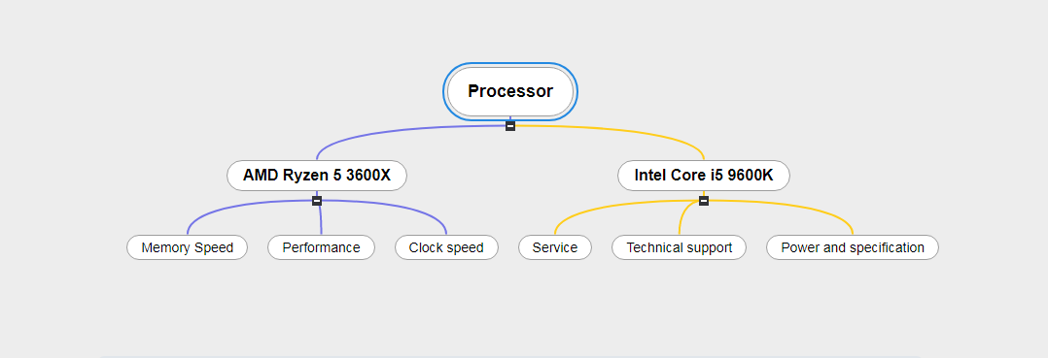
Proposed Methodology

Slide 5
1. Clock speed 2. Performance 3. CPU 4. Power 5. Memory support
Comparison Measures:

Slide 6
AMD Ryzen 5 processor is good & effective for gaming & multi-tasking. That's why I have interested to work with it. On the other hand, Intel core i5 9600K is already used for office work & daily uses. For this reason I'm working with this.
Motivation

Slide 7
Scopes: 1. We can find out which one is more better in daily life . 2. We can detect the area of upgrade and improve. Limitation: We can only find out what is disclosed by the owner company. So the comparison will not be 100% accurate. It is depends on the comparison measures parts.
Scopes And Limitation

Slide 8


